Slide 1

Introduction to Linux
Adnan Niazi
SLU Bioinformatics Infrastructure (SLUBI)

Slide 2
What is Linux?
Linux is an open-source operating system based on Unix
Developed by Linus Torvalds in 1991
It is free and open-source software (FOSS)
Known for its security, stability, and flexibility

Slide 3
Why Learn Linux?
Widely used in HPC servers, cloud infrastructure, and embedded systems
Linux command-line interface (CLI) is a powerful environment for performing repetitive tasks, managing files, processing data, and running scripts.
Data management: Powerful tools for file handling, compression, and remote data transfer
Open-source Tools: Allows you to efficiently work with data, automate workflows, and handle large datasets.

Slide 4



Linux vs. Other Operating Systems
Linux: Open-source, highly customizable, secure
Windows: Proprietary, user-friendly, widely used in desktops
macOS: Based on Unix, proprietary, optimized for Apple hardware
Linux Distributions
Ubuntu: User-friendly, great for beginners
Fedora: Cutting-edge features, used by developers
CentOS: Stable and widely used in servers

Slide 5
Components of Linux
Key Components:
Kernel: The core of the OS, manages hardware resources.
Shell: Interface between the user and the kernel, allows command execution.
File System: Organizes and stores files in a hierarchical structure.
Graphical User Interface (optional): User-friendly desktops like GNOME, KDE, etc.

Slide 6
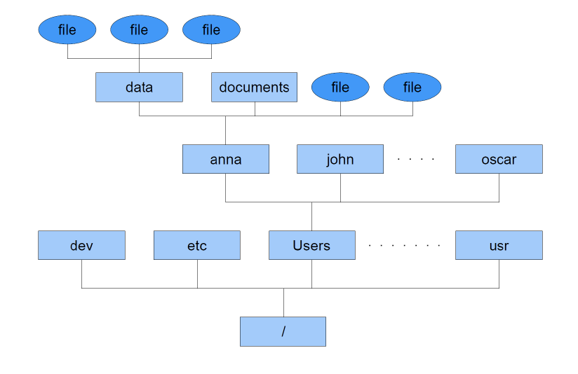
File System / Directory Tree
Home directory

Slide 7
File System – Paths
File A
File B
File C
Current working directory
data
documents
File D
Paths
Separation /
Current directory ./
Parent directory ../
adnan
johan
Absolute Paths
/Users/adnan/data/fileD
Users
Relative Paths
../fileD
/

Slide 8
Shell
Often called “command line”
Way to communicate with the system core
Bourne shell (sh)
Debian Almquist shell (dash)
Bourne-Again shell (bash)
Z shell (zsh)
C shell (csh)

Slide 9
File Management Commands
Command | What it does
ls | Lists the contents of the current directory
mkdir | Creates a new directory
mv | Moves or renames a file
cp | Copies a file
rm | Removes a file
cat | Concatenates files
less | Displays the contents of a file one page at a time
head | Displays the first ten lines of a file
tail | Displays the last ten lines of a file
cd | Changes current working directory
pwd | Prints working directory
find | Finds files matching an expression
grep | Searches a file for patterns
wc | Counts the lines, words, and characters in a file
kill | Stops a process
jobs | Lists the processes that are running

Slide 10
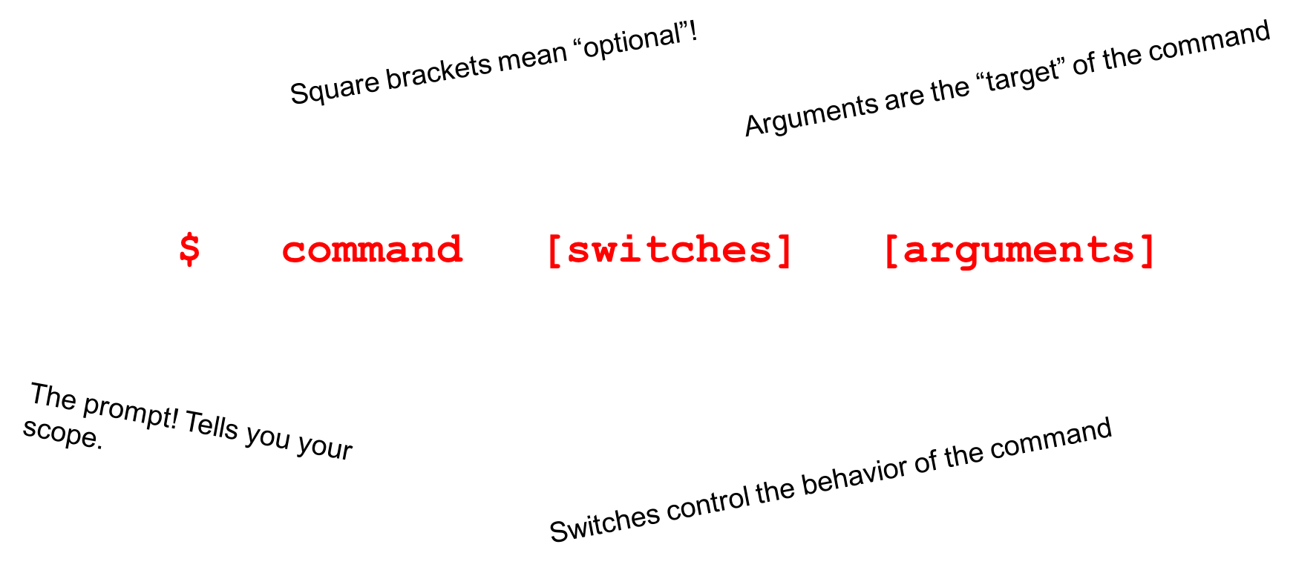
Command Line Structure
Example:
ls /Users/johan
cd /Users/johan/data
cp fileA.txt newFile.txt

Slide 11
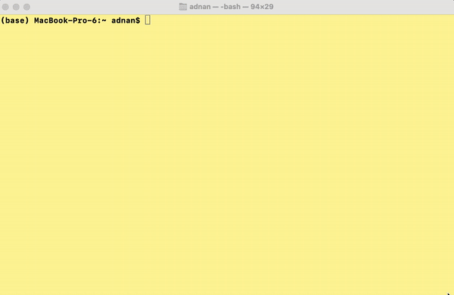
Application - Read the Manual
Help on using the command or application
Scroll up and down with the arrow keys
Quit by pressing q
How to launch:
$ man <command>
Examples:
$ man ls
$ man cp

Slide 12
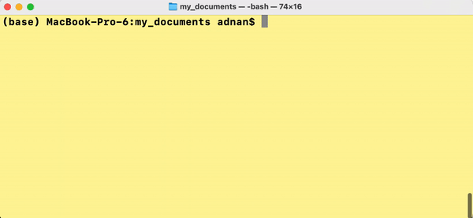
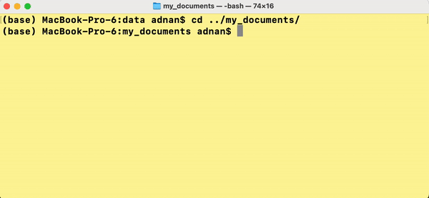
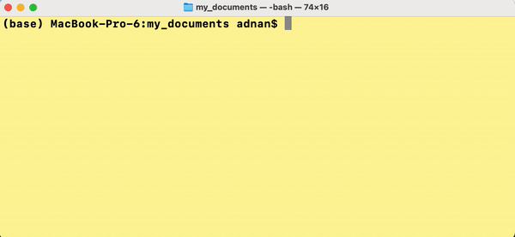
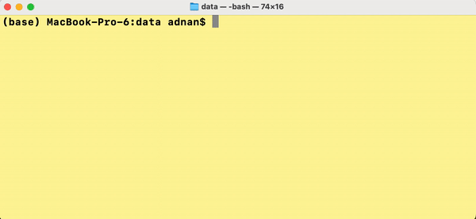
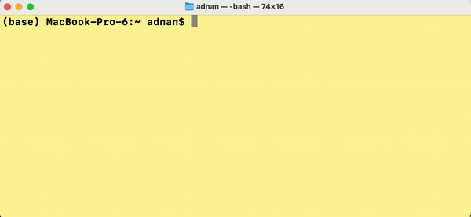
Change directory
data
my_documents
File D
Go to home directory (adnan)
$ cd
From adnan to data
$ cd data
From data to my_documents
$ cd ../my_documents
From documents to adnan
$ cd ..
From anywhere to Users
$ cd /Users
adnan
johan
Users

Slide 13
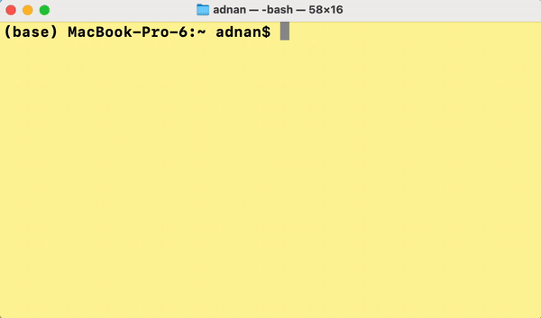
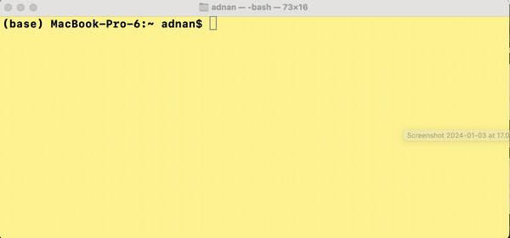
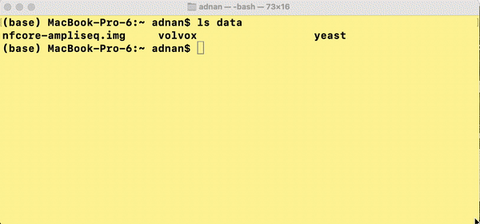
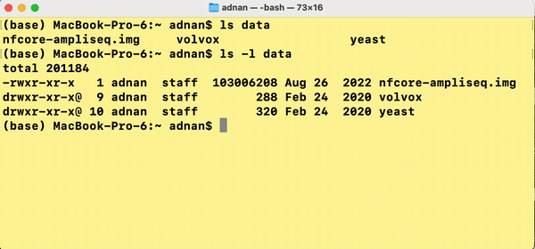
Listing contents or files
Listing the current directory
$ ls
Listing another directory
$ ls data
List with more detail
$ ls –l data
List with human readable file sizes
$ ls –lh data

Slide 14
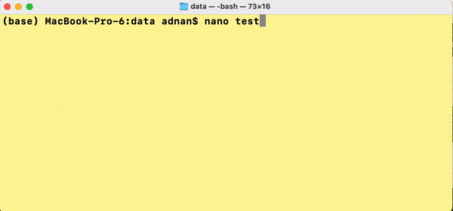
Managing Text files
$ less filename.txt
Application for only READING a file
Press q to quit
Scroll with arrow keys
$ nano filename.txt
Application for WRITING (and read) file
Exit with ctrl + x
Read more commands at the bottom of the screen

Slide 15
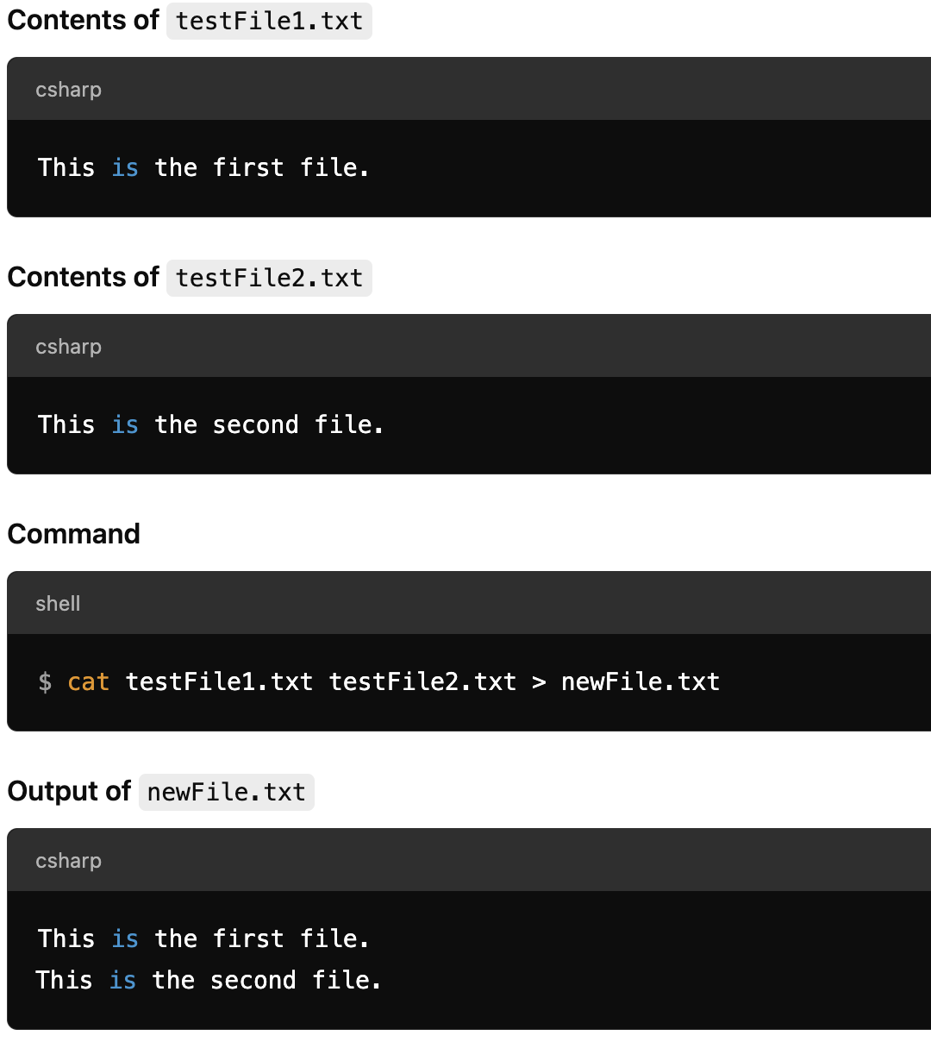
More Commands
Copy a file
$ cp testFile.txt testFile_2.txt
Copy a directory
$ cp –r data data2
Move testFile.txt to originalFile.txt
$ mv testFile.txt originalFile.txt
Concatenate files
$ cat testFile1.txt testFile2.txt > newFile.txt
Remove file
$ rm testFile_2.txt

Slide 16
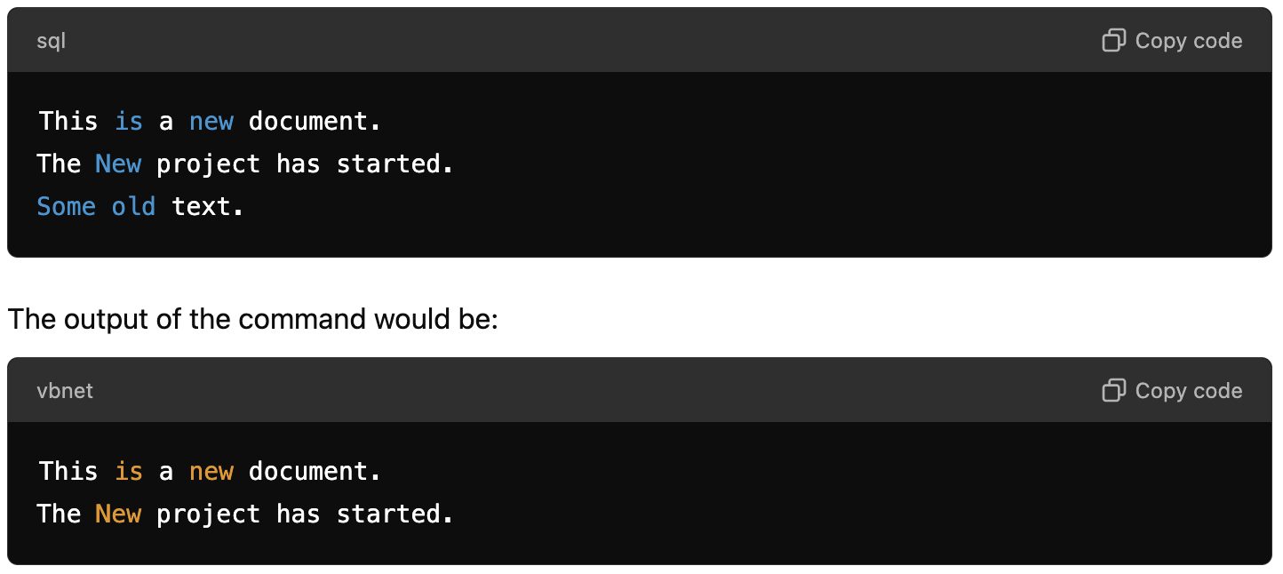
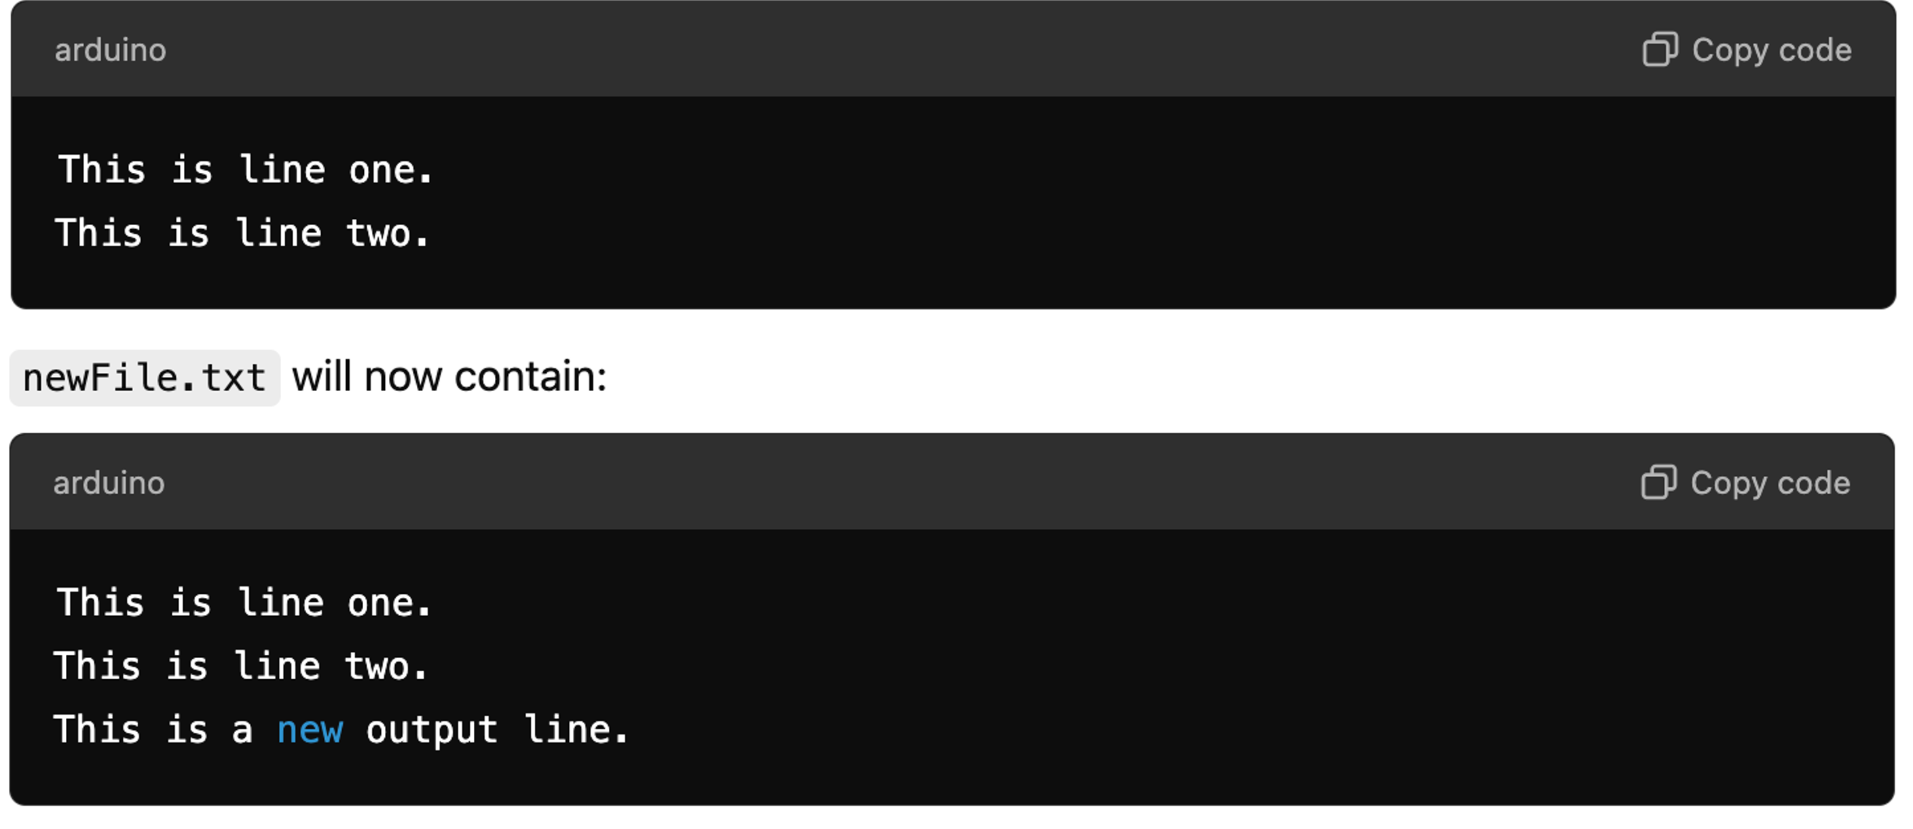
Streams
Stream output to a file
$ echo “create a new file” > newFile.txt
Append output to the end of file
$ echo “This is a new output line”>> newFile.txt
Input redirection
$ grep -i “New” < newFile.txt

Slide 17
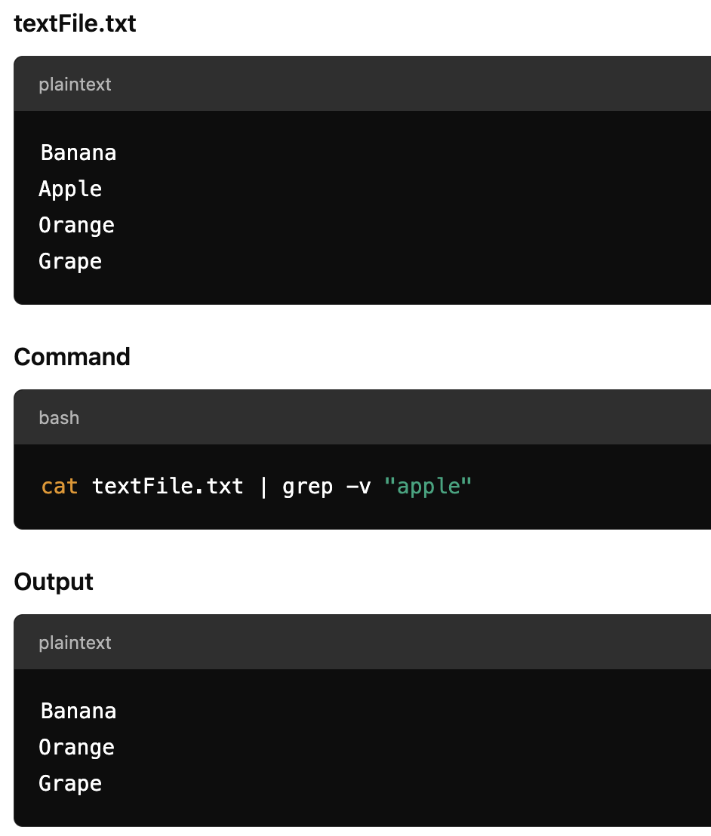
Grep Commands
Case insens­itive search
grep -i
Recursive search
grep -r
Inverted search
grep -v

Slide 18
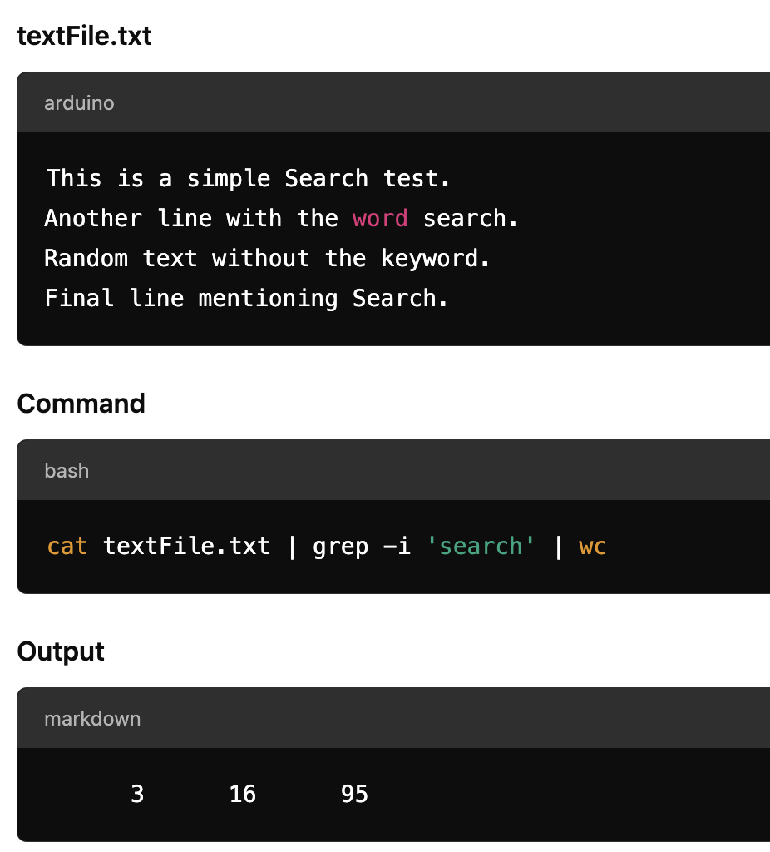
Piping
cmd1 | cmd2
Passes output from one program into another
Examples:
$ cat textFile.txt | grep –i ‘find me’
$ ls –l | less
$ cat textFile.txt | tail
$ cat textFile.txt | grep –i ‘search’ | wc

Slide 19
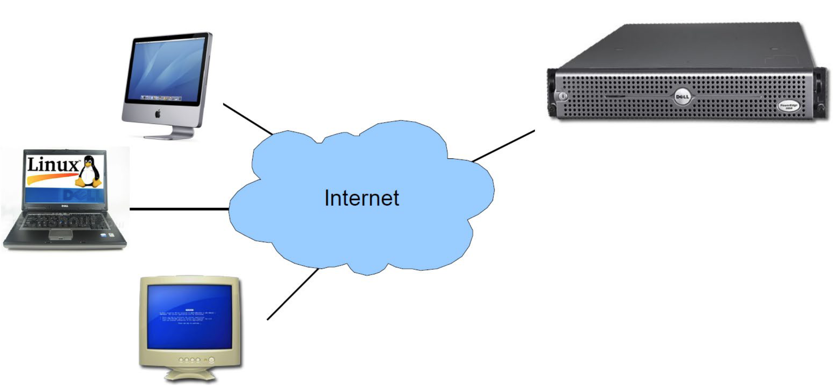
Remote Access
SSH
Secure Shell
Encrypted connection
The most common way of accessing servers
ssh username@rackham.uppmax.uu.se

Slide 20
More Reading
Thank You!
Practice https://swcarpentry.github.io/shell-novice/
Summary https://swcarpentry.github.io/shell-novice/reference.html
Cheatsheet https://cheatography.com/davechild/cheat-sheets/linux-command-line
Bioinformatics one-liners
https://github.com/stephenturner/oneliners
https://github.com/crazyhottommy/bioinformatics-one-liners

Slide 21
Exercise
Make a folder with your name
mkdir yourname
Navigate to your folder
cd yourname
Create an empty file
nano randomfile
Rename randomfile
mv randomfile randomfile2
Delete random file
rm randomfile2
Create a directory
mkdir randomdir
Delete the directory
rm -r randomdir

